Slide 1
Building with Generative AI on AWS using PartyRock, Amazon Bedrock, and Amazon Q
NAME
(PRONOUNS)
TITLE
COMPANY
Notes:
Banjo

Slide 2
About Me
Introduce self

Slide 3
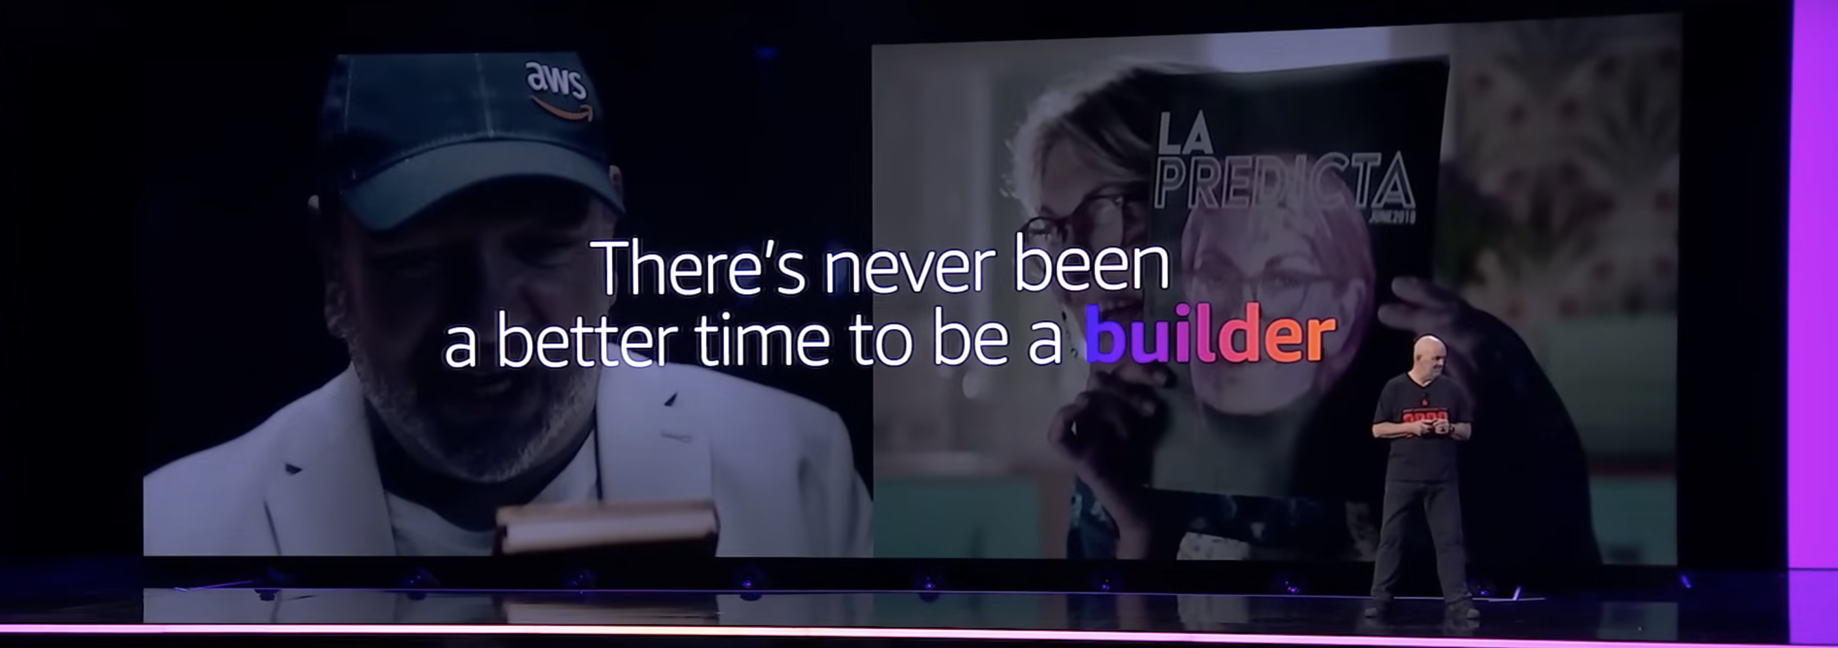
Notes:
With generative AI, every possible workload has a chance to be re invented. We are staring with chatbots and assistants, but as we build new use cases and workflows arise that can be enhanced with generative AI. This is the time to explore what is possible, and push the limits of what we can do. Now is the time to build!!!!

Slide 4
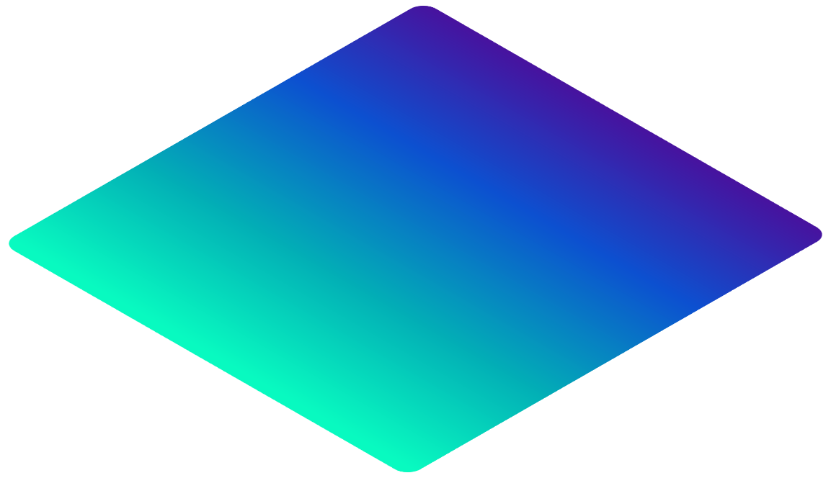

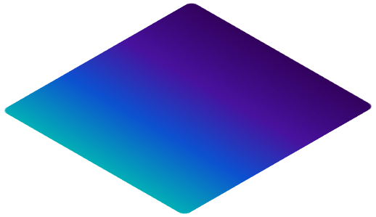


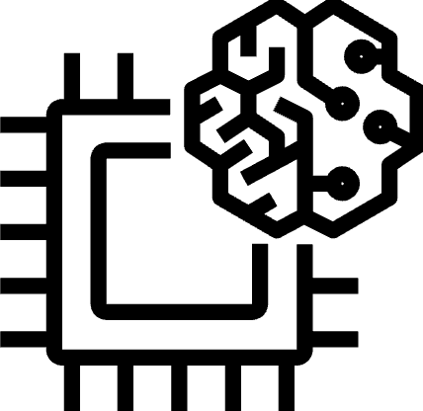
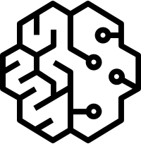


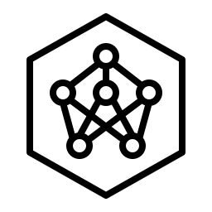
APPLICATIONS THAT LEVERAGE FMs
Amazon Q
Amazon Q in
Amazon QuickSight
Amazon Q in
Amazon Connect
TOOLS TO BUILD WITH FMS AND LLMS
The Generative AI Stack
Amazon Bedrock
Guardrails
Agents
Customization capabilities
INFRASTRUCTURE FOR FM TRAINING & INFERENCE
GPUs
Trainium
Inferentia
SageMaker
UltraClusters
EFA
EC2 Capacity Blocks
Nitro
Neuron
Notes:
3 layers to the GenAI Stack
Hardware – Chips, compute, training inference.
API – Bedrock, this is where the builders will be using the most.
Applications – Think of Amazon Q, a generative AI assistant

Slide 5
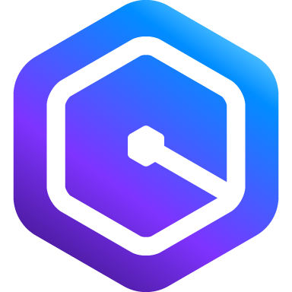
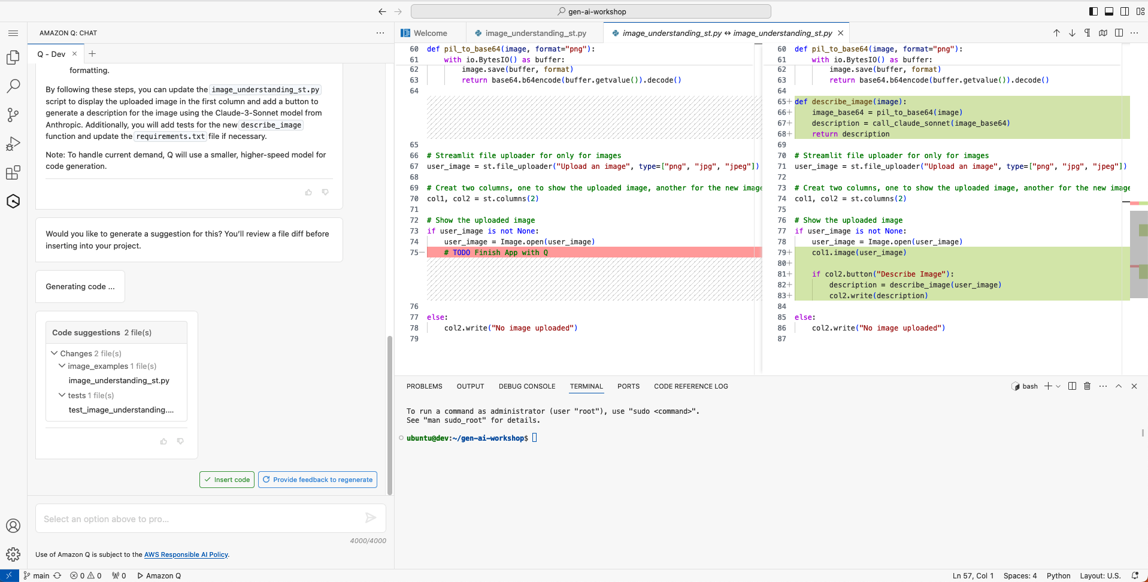
Amazon Q Developer
The most capable generative AI–powered assistant for software development
Notes:
Amazon Q lives where you work, right inside your IDE and the AWS Console
Can help with coding, debugging, refactoring tasks
Free to get started, no need for an AWS Account
VScode, IntellJ and Visual Studio supported

Slide 6




Amazon Bedrock
The easiest way to build and scale generative AI applications with foundation models
Contextual answers, summarization, paraphrasing
Text summarization, generation, Q&A, search, image generation
Summarization, complex reasoning, writing, coding
Text generation, search, classification
Q&A and reading comprehension
Text summarization, Q&A, text classification, text completion, code generation
High-quality images and art
Jurassic-2 Ultra
Jurassic-2 Mid
Amazon Titan Text Premier
Amazon Titan Text Lite
Amazon Titan Text Express
Amazon Titan Text Embeddings
Amazon Titan Text Embeddings V2
Amazon Titan Multimodal Embeddings
Amazon Titan Image Generator
Claude 3 Opus
Claude 3 Sonnet
Claude 3 Haiku
Claude 2.1
Claude 2
Claude Instant
Command
Command Light
Embed English
Embed Multilingual
Command R+
Command R
Llama 3 8B
Llama 3 70B
Llama 2 13B
Llama 2 70B
Mistral Large
Mistral 7B
Mixtral 8x7B
Stable Diffusion XL1.0
Stable Diffusion XL 0.8
Notes:
Amazon Bedrock is a fully managed service that offers a choice of high-performing foundation models (FMs) from leading AI companies like Stability AI, Anthropic, and Meta, via a single API, along with a broad set of capabilities you need to build Generative AI applications with security, privacy, and responsible AI.
Since Amazon Bedrock is serverless, you don't have to manage any infrastructure, and you can securely integrate and deploy Generative AI capabilities into your applications using the AWS services you are already familiar with.

Slide 7
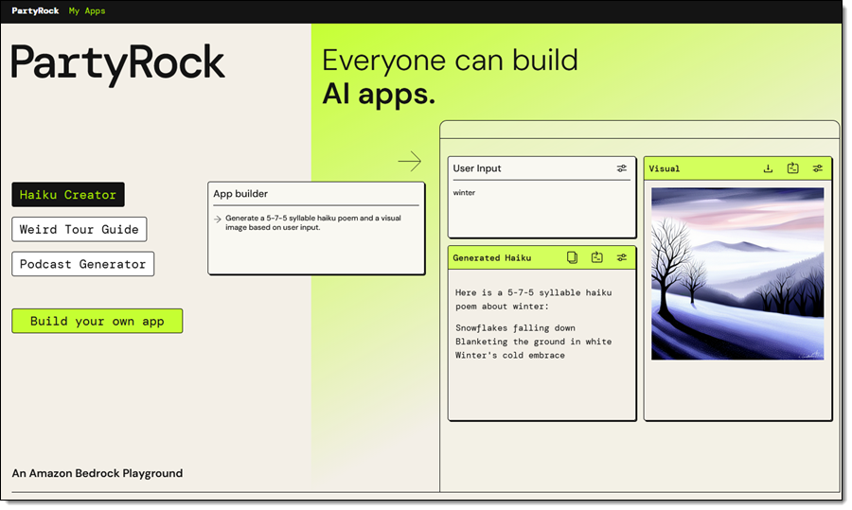
PartyRock
Build generative AI Apps with no code
No AWS Account required
Notes:
PartyRock is a shareable no code Generative AI app building playground, that allows you to experiment with prompt engineering in a hands-on and fun way. In just a few clicks, you can build, share, and remix apps, to get inspired while playing with Generative AI. For example, you can:
Build an app to generate dad jokes on the topic of your choice.
Create and play a virtual trivia game online with friends from around the world.
Create an AI storyteller to guide your next fantasy roleplaying campaign.

Slide 8
Workshop

Slide 9
Modules
Build Generative AI Applications with PartyRock
Use Foundation Models in Amazon Bedrock
Chat with your Documents

Slide 10
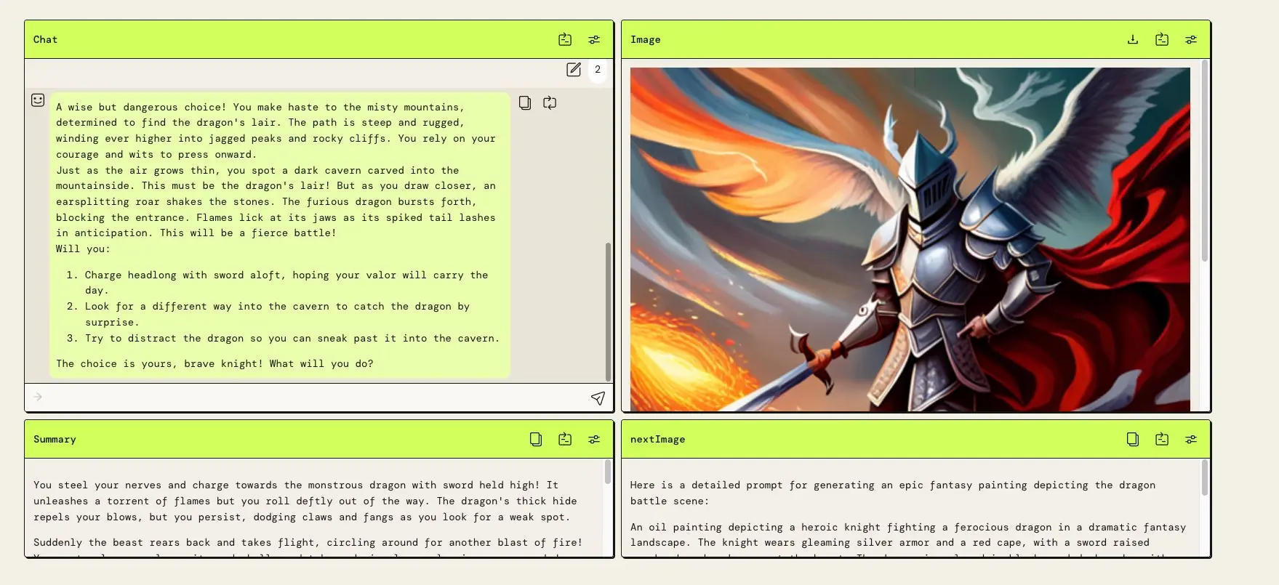
Build Generative AI Applications with PartyRock
Notes:
Build Generative AI Applications with PartyRock: Learn how to quickly build Generative AI applications with no code.
Should take around 25 minutes

Slide 11
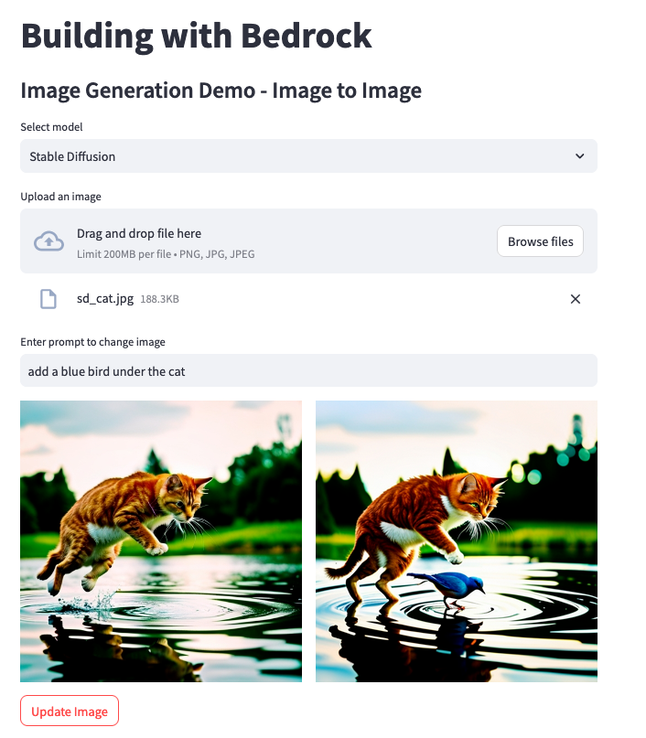
Use Foundation Models in Amazon Bedrock
Notes:
Use Foundation Models in Amazon Bedrock Learn how to use various foundation models to generate text and images using Amazon Bedrock.
This will be a coding section you will use Amazon Q + CW to write and debug.
This section should take around an hour

Slide 12
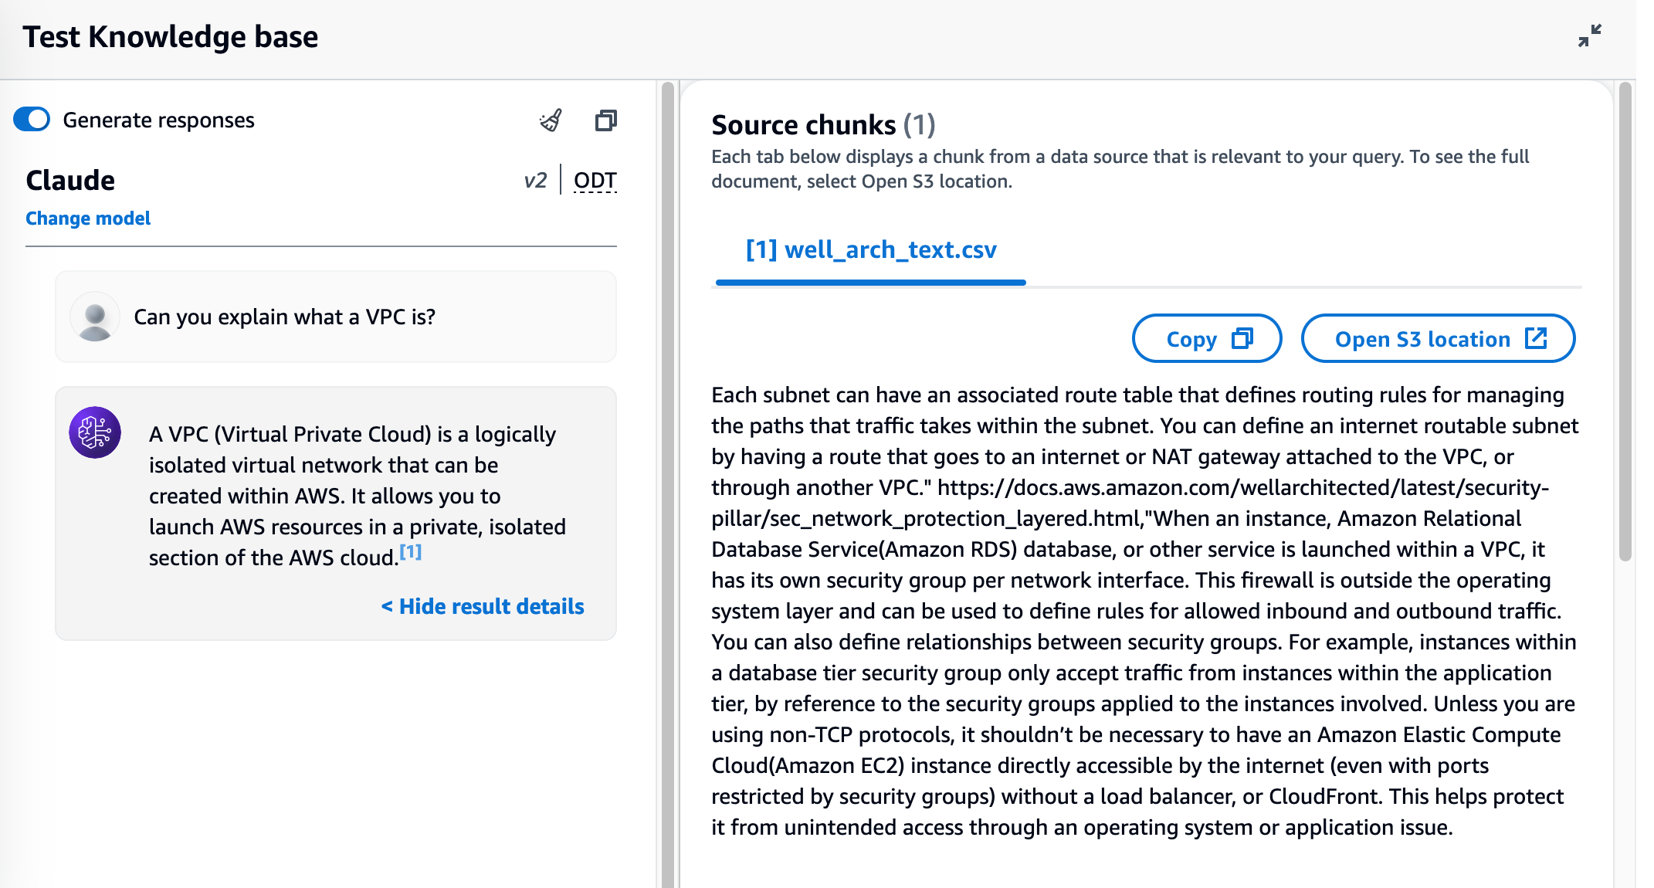
Chat with your Documents
Notes:
Chat with your Documents Learn how to use Amazon Bedrock to "Chat with your documents". We will explore how to build RAG applications highlighting Knowledge Bases, embeddings, and agents.
You will build RAG applications using Amazon bedrock, will be coding as well. Should take around 45 minutes

Slide 13
Lets Build!

Slide 14
Enter Workshop Studio Link
Notes:
Tell folks to login with builder id, or the one time email password.

Slide 15
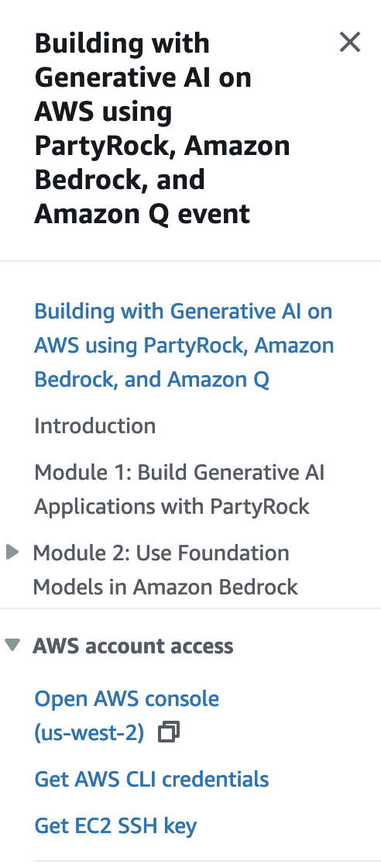
Notes:
Tell folks to login with the AWS Account provided. Do not use your own account. Make sure to repeat this. Tell folks to log out of their AWS account. Login is on the left side menu

Slide 16
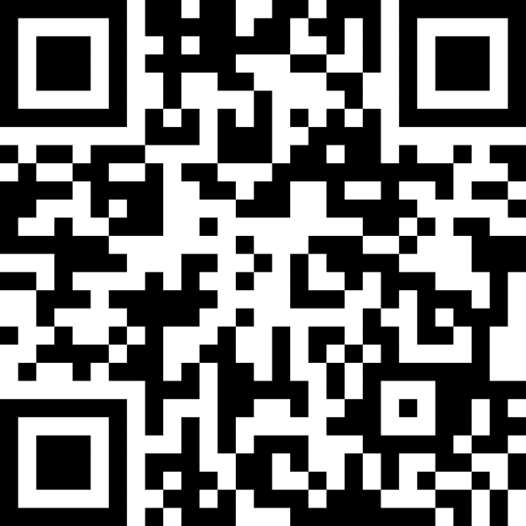
Share your feedback about the workshop
1 min Community Survey
Notes:
Dear speaker: we would really appreciate if you keep this slide and get attendees to answer it. It takes less than 1 minute, and it will help us a lot support the community better and addressing their feedback.
Thanks a lot.
AWS Community team

